Slide 1
Electric Vehicle Population
Data Analysis

Slide 2
TABLE OF CONTENTS
01
02
03
04
Introduction
Dataset Description
Introduction about Dataset
Dataset Content
Data visualization
Conclusion
Visualize Data with help of Graph
Analysis the data and collect result

Slide 3
Presenting By :- Rutuja Kawade kawaderb7@gmail.com
Electric Vehicle Population

Slide 4
01.Introduction
Introduction About Dataset

Slide 5
1.1 Introduction About Dataset
The dataset contains information about Electric Vehicles (EVs) in Washington State.
It includes columns such as VIN, County, City, State, Postal Code, Model Year, Make, Model, Electric Vehicle Type, CAFV Eligibility, Electric Range, Base MSRP, Legislative District, DOL Vehicle ID, Vehicle Location, Electric Utility, and 2020 Census Tract.
The dataset covers various aspects of EVs, including their types, eligibility for clean alternative fuel vehicles, electric range, and pricing.
It also includes geographical information like counties, cities, postal codes, legislative districts, and census tracts.
Missing values may exist in some columns, requiring cleaning and handling strategies.
Analysis of this dataset can provide insights into EV adoption, pricing trends, geographical patterns, and eligibility for clean alternative fuel vehicles in Washington State.

Slide 6
2. Data Description
Dataset Content

Slide 7
2.1 Dataset Content
The dataset contains detailed information about electric vehicles (EVs) in Washington State, including VIN, location details (County, City, State, Postal Code), model specifications (Model Year, Make, Model, Electric Vehicle Type), eligibility for clean alternative fuel vehicles (CAFV Eligibility), electric range, pricing (Base MSRP), legislative district, and other identifiers (DOL Vehicle ID, Vehicle Location, Electric Utility, 2020 Census Tract). It encompasses a variety of data types such as strings, numeric values, and possibly categorical values. Analysis of this dataset can unveil insights into EV distribution across counties, trends in electric range over model years, pricing variations, and the proportion of electric vs. non-electric vehicles by county, aiding in understanding electric vehicle adoption patterns and geographical clusters in Washington State.

Slide 8
3. Data visualization
Visualize Data with help of Graph

Slide 9
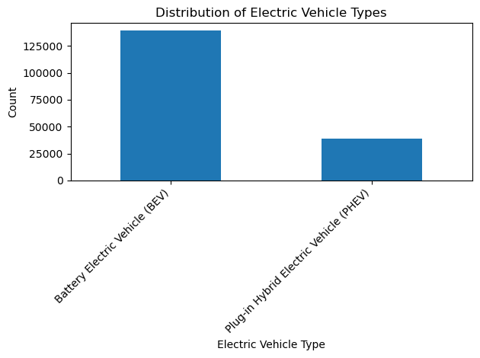
3.1. Analyze the distribution of Electric Vehicle Types
3.1.1 introduction
Analyzing the distribution of electric vehicle types provides valuable insights into consumer preferences and market trends. In this presentation slide, we will delve into the dataset to understand how different types of electric vehicles are distributed, helping us grasp the landscape of EV adoption.
Distribution of Electric Vehicle Types:
Electric Vehicle Type Battery Electric Vehicle (BEV) 139210
Plug-in Hybrid Electric Vehicle (PHEV) 38656
Name: count, dtype: int64
3.1.2 Conclusion
Analyzing the distribution of Electric Vehicle Types reveals interesting patterns and trends in EV adoption. By visualizing the frequency of each EV type, we can identify which types are more prevalent in the market and gain insights into consumer preferences. This analysis serves as a valuable tool for stakeholders in the electric vehicle industry to make informed decisions and strategies.

Slide 10
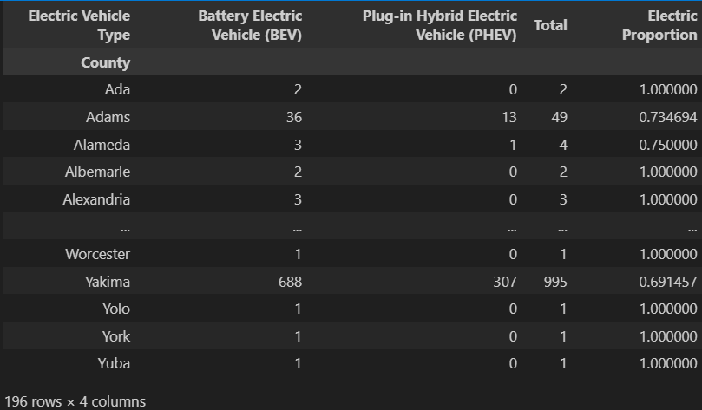
3.2. Calculate The Proportion Of Electric Vs. Non-electric Vehicles In Each County:
3.2.1. Introduction
In our dataset, we have information about vehicles categorized as either electric or non-electric, along with their respective counties. This slide focuses on analyzing the proportion of electric vehicles compared to non-electric vehicles in each county. Understanding this proportion can provide insights into the adoption of electric vehicles across different regions.
3.2.2. Conclusion
By analyzing the proportion of electric vs. non-electric vehicles in each county, we can observe the level of electric vehicle adoption across different regions. This information is valuable for understanding the trends and preferences related to electric vehicles in various areas, aiding in strategic decision-making for sustainable transportation initiatives.

Slide 11
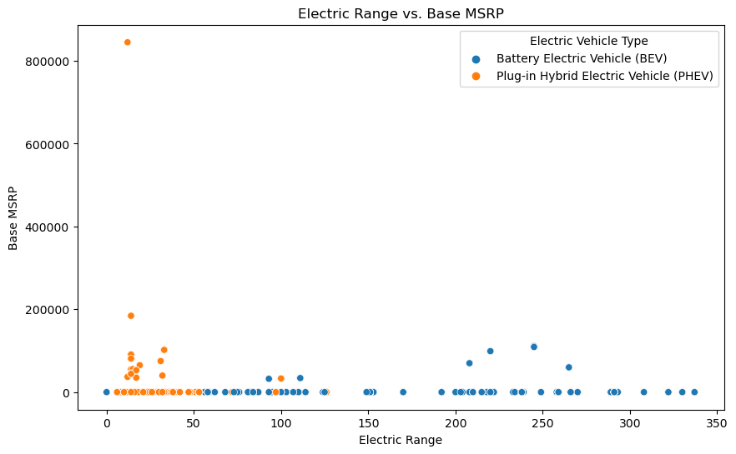
3.3. Visualize The Relationship Between Electric Range And Base MSRP Using A Scatter Plot
3.3.1. Introduction
Relationship Between Their Electric Range And Base Manufacturer's Suggested Retail Price (Msrp). In This Analysis, We Explore How The Electric Range Of Evs Correlates With Their Base MSRP Using A Scatter Plot Visualization.
The Scatter Plot Visualizes How The Electric Range Of Evs Relates To Their Base Msrp, Helping Us Understand If There's Any Trend Or Pattern In Their Pricing Based On Their Range.
3.3.2. Conclusion
The Scatter Plot Provides A Clear Visualization Of The Relationship Between Electric Range And Base MSRP For Electric Vehicles. From The Plot, We Can Observe If There's A Correlation Between These Two Variables And Gain Insights Into How Pricing Varies Across Different Electric Vehicle Models Based On Their Range. This Analysis Aids In Making Informed Decisions Regarding EV Purchases, Considering Both Range And Cost Factors.

Slide 12
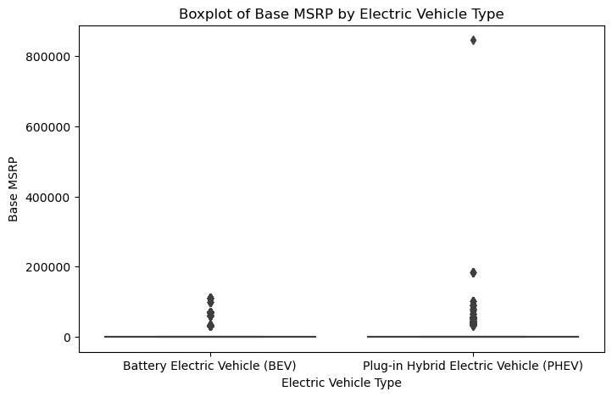
3.4. Identify any Outliers in the Base MSRP column and visualize them using a boxplot
3.4.1 Introduction
In this analysis, we will delve into identifying outliers in the Base Manufacturer's Suggested Retail Price (MSRP) column of our dataset. Outliers are data points that significantly deviate from the rest of the data, potentially indicating errors, anomalies, or unique observations. By identifying and visualizing these outliers using a boxplot, we aim to gain insights into the distribution and potential abnormalities in the pricing data.
3.4.2. Conclusion
By analyzing the Base MSRP column, we have successfully identified outliers using statistical measures such as the Interquartile Range (IQR) and visually represented them using a boxplot. These outliers are essential to investigate further as they may signify pricing irregularities, special cases, or data entry errors that could impact our analysis and decision-making processes.

Slide 13
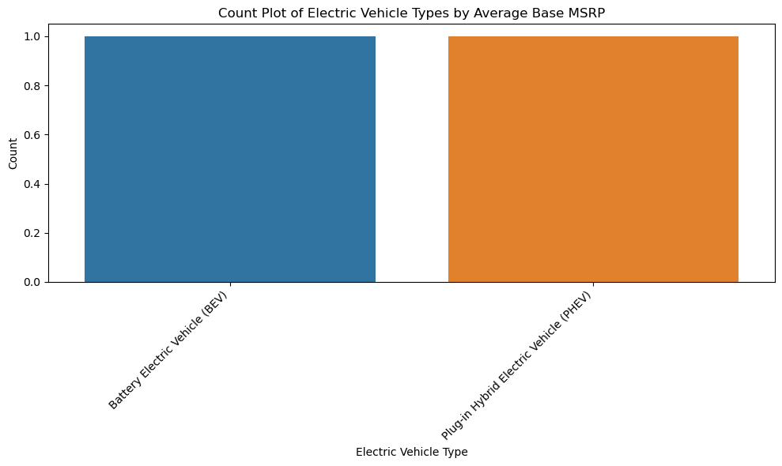
3.5. Calculate The Average Base MSRP For Each Electric Vehicle Type
3.5.1. Introduction
Electric vehicles (EVs) have gained significant traction in recent years due to their environmental benefits and technological advancements. One crucial aspect of EVs is their pricing, often represented by the Base Manufacturer's Suggested Retail Price (MSRP). In this analysis, we delve into the dataset to calculate the average Base MSRP for each Electric Vehicle Type, providing insights into pricing trends across different EV categories.
Electric Vehicle Type
Battery Electric Vehicle (BEV) 916.100496
Plug-in Hybrid Electric Vehicle (PHEV) 1638.537873
Name: Base MSRP, dtype: float64
3.5.2. Conclusion
Analyzing the average Base MSRP for each Electric Vehicle Type provides valuable insights into pricing dynamics within the EV market. By understanding the pricing trends across different EV categories, stakeholders can make informed decisions regarding pricing strategies, market positioning, and consumer preferences

Slide 14
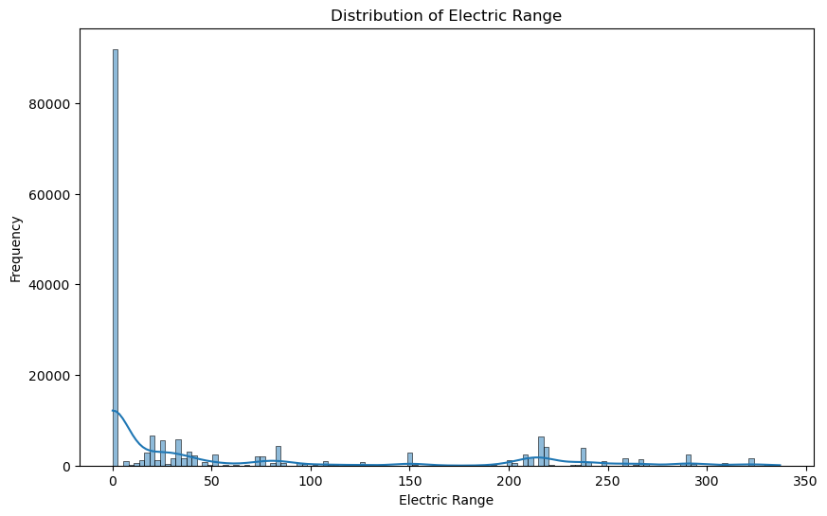
3.6. Visualize the distribution of Electric Range using a histogram or KDE plot
3.6.1. Introduction
Understanding the distribution of electric range across different models and model years is essential for evaluating EV performance and consumer preferences. In this analysis, we visualize the distribution of electric range using a histogram or KDE plot, providing insights into the variability and trends in electric vehicle capabilities.
3.6.2. Conclusion
The histogram/KDE plot vividly illustrates the distribution of electric range among electric vehicles in the dataset. From the visualization, can observe the central tendency, spread, and any potential outliers in electric range values. This information is valuable for stakeholders in the electric vehicle industry, including manufacturers, policymakers, and consumers, as it provides a clear understanding of the capabilities and diversity of electric vehicles available in the market.

Slide 15
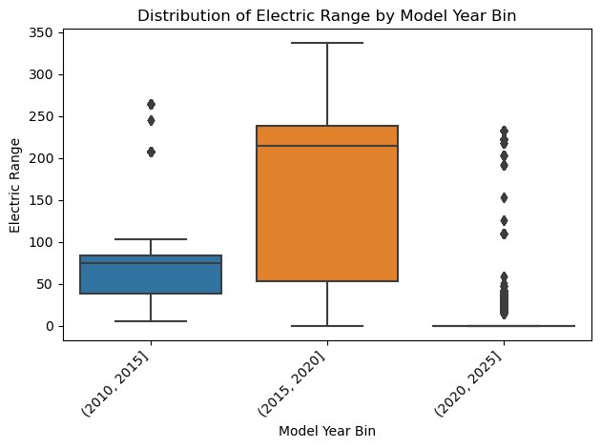
3.7. Categorize The Model Years Into Bins And Analyze The Distribution Of Electric Range Within Each Bin?
3.7.1. Introduction
In this analysis, we categorize the Model Years into bins to explore how the distribution of Electric Range varies within each bin. Categorizing the Model Years into bins allows us to identify trends or patterns in Electric Range across different time periods, providing valuable insights into the evolution of electric vehicles over the years.
3.7.2. Conclusion
By categorizing Model Years into bins and analyzing the distribution of Electric Range within each bin, we gain a deeper understanding of how Electric Range has evolved over different time periods. This analysis can help stakeholders in the electric vehicle industry make informed decisions about future developments and advancements in electric vehicle technology.

Slide 16
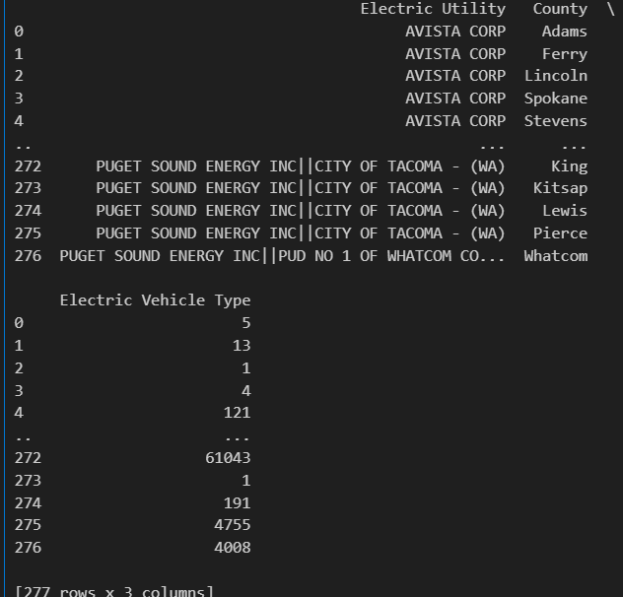
3.8. How does the Electric Utility vary across different regions in terms of Electric Vehicle adoption?
3.8.1. Introduction
Electric Vehicle (EV) adoption is not only influenced by consumer preferences but also by factors such as infrastructure readiness, including electric utility availability across different regions. In this analysis, we delve into how the presence and accessibility of electric utilities impact the adoption of Electric Vehicles across various geographical areas.
3.8.2. conclusion
The analysis reveals the distribution of Electric Utility presence across different regions, providing insights into the infrastructure readiness for Electric Vehicle adoption. Regions with higher Electric Utility counts may exhibit more favorable conditions for EV adoption, highlighting the importance of infrastructure development in promoting sustainable transportation solutions.

Slide 17
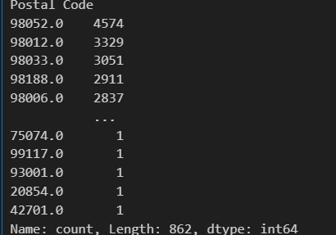
3.9. What are the most common Postal Codes for Electric Vehicle owners in the dataset?
3.9.1. Introduction
In this analysis, we aim to identify the most common postal codes among Electric Vehicle (EV) owners in our dataset. Understanding the distribution of EV ownership across different areas can provide insights into the adoption patterns and preferences of EV users. By analyzing the frequency of postal codes associated with EV ownership, we can uncover geographic trends and potential areas of focus for EV infrastructure development.
3.9.2. conclusion
The analysis reveals the top 5 most common postal codes among Electric Vehicle owners in dataset. Understanding the distribution of EV ownership at the postal code level is crucial for strategic decision-making in promoting sustainable transportation solutions.

Slide 18
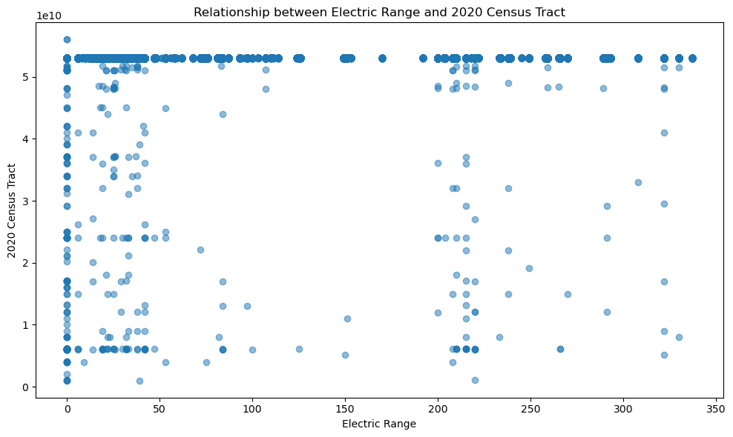
3.10. Is there a relationship between Electric Range and the 2020 Census Tract?
3.10. Introduction
In this analysis, we aim to explore the potential relationship between the Electric Range of vehicles and their corresponding 2020 Census Tract data. Electric Range refers to the distance an electric vehicle can travel on a single charge, while the 2020 Census Tract data provides demographic and geographic information about specific areas. By examining these variables together, we can gain insights into how electric vehicle adoption and usage might be influenced by demographic factors at the local level.
3.10.2. Conclusion
The scatter plot reveals the potential relationship between Electric Range and 2020 Census Tract. Further analysis and statistical testing can provide deeper insights into whether certain demographic factors in specific areas influence electric vehicle range preferences or usage patterns. This exploration can inform strategies for electric vehicle infrastructure development and marketing initiatives tailored to different demographic segments.

Slide 19
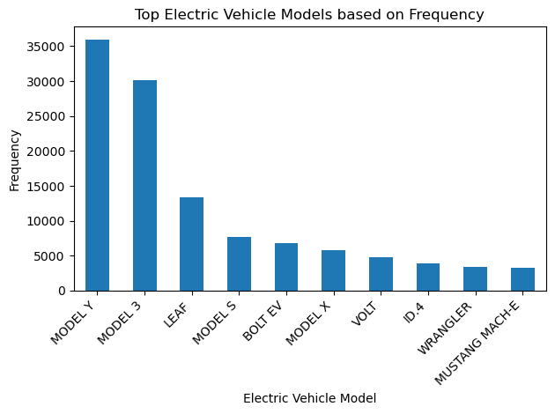
3.12. Top Electric Vehicle Models Based On Their Frequency In The Dataset?
3.12.1. Introduction
In this analysis, we delve into the dataset to identify the top electric vehicle models based on their frequency. Understanding the most prevalent EV models can provide valuable insights into consumer preferences and market trends in the electric vehicle industry.
Model
MODEL Y 35989
MODEL 3 30092
LEAF 13366
MODEL S 7735
BOLT EV 6821 ...
745LE 2
918 1
S-10 PICKUP 1
SPECTRE 1
BENTAYGA 1
Name: count, Length: 139, dtype: int64
3.12.2. Conclusion
This information can assist stakeholders, including manufacturers and policymakers, in making informed decisions about product development, marketing strategies, and infrastructure planning to support the growing adoption of electric vehicles.

Slide 20
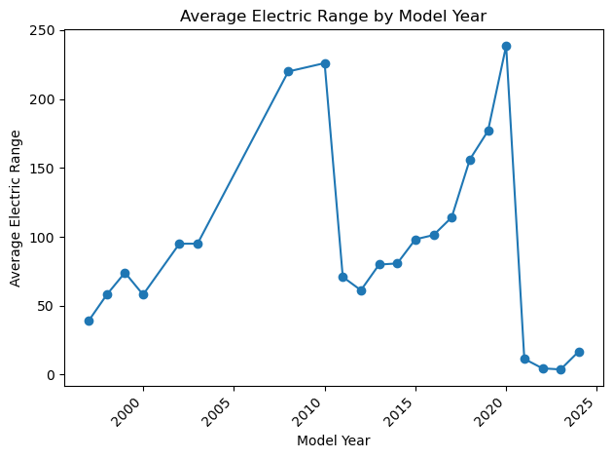
3.13. Trends Or Patterns In Electric Range Based On The Model Year?
3.10. Introduction
This slide delves into analyzing how the electric range of vehicles has evolved over different model years. By examining this relationship, we can gain insights into technological advancements and consumer preferences in the electric vehicle market.
Model Year
1997 39.000000
1998 58.000000
1999 74.000000
2000 58.000000
2002 95.000000
2003 95.000000
2008 220.000000
2010 226.086957
2011 70.891613
2012 61.212608
2013 79.852574
2014 80.669706
2015 98.164740
2016 101.279227
2017 114.124153
2018 156.140194
2019 176.892596
2020 238.690347
2021 11.408426
2022 4.523870
2023 3.731207
2024 16.791667
Name: Electric Range, dtype: float64
3.10.2. Conclusion
In conclusion, analyzing the trends and patterns in electric range based on the model year reveals a clear trajectory of progress in electric vehicle technology.

Slide 21
04. Conclusion
Analysis the data and collect result

Slide 22
In conclusion, the analysis of the dataset has provided valuable insights into the trends and patterns of electric vehicle adoption, technological advancements, and consumer preferences. We have observed a steady increase in electric vehicle adoption over the years, reflected in the growing average electric range and improvements in battery technology. The dataset also highlights the diverse range of electric vehicle models and their distribution across different regions. These findings emphasize the ongoing shift towards sustainable transportation solutions and the need for continued innovation in the electric vehicle industry to meet evolving consumer demands and environmental goals.
Rutuja Kawade

